Slide 1
QEP Topic Reveal
QEP Core & Implementation Teams
December 2015
Notes:
Maryann Aucompaugh (With Energy and Excitement!)

Slide 2
After 18 months of hard work,
we’ve revealed the winning
Quality Enhancement Plan Topic!
Notes:
Maryann Aucompaugh (With Energy and Excitement!)

Slide 3
And the definitive winner is…
Notes:
Maryann Aucompaugh (With Energy and Excitement!)

Slide 4
MAP: My Academic Pathway!
Notes:
Maryann Aucompaugh (With Energy and Excitement!)

Slide 5
With 40.25% of the entire vote AND…
37.5% of Faculty
38.19% of Staff
43.11% of Students
40% of Board of Trustees
44.19% of the Advisory Board
Notes:
Heather McCracken
Talk about how this topic was the number one choice for each of those groups.

Slide 6
Including a total of 504 votes from:
121 Faculty
151 Staff
189 Students
10 Board of Trustees
46 Advisory Board Members
Notes:
Heather McCracken
This is the TOTAL number of votes and not the number of votes just for MAP.

Slide 7
Overall Results:
2nd Place:
I AM Advising!: Advising Matters – 26.91%
3rd Place:
BOSS: Boost Online Student Success – 21.17%
4th Place:
Can you DIG IT?: Developing Innovative Guidance for Instructional Technology – 12.53%
Notes:
Sandra Thompson
List each topic and the percentage vote. You can round up or down for ease of talking.

Slide 8
Vote Breakdown
 | 1st Place | 2nd Place | 3rd Place | 4th Place
Faculty | MAP | I AM Advising! | BOSS | Can you DIG IT?
 | 37.5% | 27.43% | 26.79% | 9.73%
Staff | MAP | I AM Advising! | BOSS | Can you DIG IT?
 | 38.19% | 31.94% | 21.23% | 9.73%
Students | MAP | I AM Advising! | BOSS | Can you DIG IT?
 | 43.11% | 22.16% | 22.09% | 12.57%
BOT | MAP | I AM Advising! | BOSS | Can you DIG IT?
 | 40% | 40% | 10% | 10%
Advisory | MAP | I AM Advising! | Can you DIG IT? | BOSS
 | 44.19% | 23.81% | 29.27% | 4.88%
Notes:
Sandra Thompson
Highlight that the places were the same for each group except Advisory Committee which flipped the 3rd and 4th place choices.

Slide 9
More about MAP: My Academic Pathway
Objective: To provide early advising for career and program selection in order to reduce delayed program completion, exhausting financial aid prior to completing a program of study, and to help students reach employment in less time.
Data Support: This area of focus was mentioned in multiple surveys by students, faculty, and staff, including the QEP online survey and the 2014 PD Day faculty and staff forum.
Strategic Plan Support: Learning First (Goal #1)
Notes:
Jamee Stiffler

Slide 10
Why are we creating a QEP?
SACSCOC Articles of Accreditation!
Standard 2.12:
The institution has developed an acceptable Quality Enhancement Plan (QEP)
that includes an institutional process for identifying key issues emerging from institutional assessment
and focuses on learning outcomes and/or the environment supporting student learning
and accomplishing the mission of the institution.
Notes:
Jamee Stiffler

Slide 11
Why? Cont’d…
Mandatory for reaffirmation
Supplements our College Mission and Goals
Improve student learning (Learning College)
Opportunity to work with others across the college and in order to get input from students, faculty, staff, trustees, & community members
Notes:
Jamee Stiffler

Slide 12
QEP Core Team: Timeline
June 2014: QEP Core Team selected
October 2014: Marketing/TEASE campaign
College-wide QEP themed screensaver
QEP Staff Announcements
Visual promotions (i.e. QEP t-shirts, buttons, posters)
QEP Webpage
Mid-October 2014: Launch Events Student Activity Day
At Lee, Harnett, & Chatham Campuses
Sweet Treats Reception (Faculty & Staff Launch)
Staff & Student QEP Survey
Notes:
David Hartman – Emphasize how reflective the Core Team process was to select the QEP Topic.
June 2014 – The QEP Core Team was selected 1.5 years ago. They were tasked with finding a QEP Topic to guide us through the next decade.
October 2014 - Marketing/TEASE Campaign – The Core Team began marketing the QEP to CCCC Faculty, Staff, Students, & the Public. They made QEP T-shirts, Buttons, Posters, and YouTube Videos to promote the QEP.
October 2014 – The Core Team launched the QEP Selection process to Faculty and Staff at the Sweet Treats Reception and to Students at Student Activity Day in October 2014.

Slide 13
QEP Core Team: Timeline Cont’d.
Fall 2014
Workshops
Updated Presidential Council on process
Professional Development Day – Guided Activity
Online QEP Survey
Spring 2015
Online QEP Survey
Focus groups
Continuing Education Survey
Student Activity Day - Videos
Notes:
David Hartman – Emphasize how reflective the Core Team process was to select the QEP Topic.
Fall 2014
The QEP Core Team held multiple workshops for faculty and staff to describe the process and to gather information about what topics could be considered as a potential QEP Topic.
Updated Presidents’ Council on our progress
An interactive Staff Development Day session last year helped us to gather a lot of suggestions for the QEP.
Spring 2015
The Online QEP Survey gathered suggestions from over 400 Faculty, Staff, In-Person and Online Students in 2014-2015.
The QEP Core Team held multiple focus groups with active learning activities to identify more QEP topic options.
More information was gathered from a paper Continuing Education Survey and Recorded Student Activity Day interviews on all three campuses.

Slide 14
QEP Core Team: Timeline Cont’d.
Summer 2015
Analyzed ALL Assessment data. Reviewed topics to make sure each suggestion:
Supported Student Learning
Feasible
Viable
Measurable
Supported by Data
Narrowed to Top 10 → Top 6 topics
Fall 2015
President’s Council approval of Top 3 4 topics
Promoted the Final Topics in Discussion Sessions & Marketing
Final Vote in October 2015!
Notes:
David Hartman – Emphasize how reflective the Core Team process was to select the QEP Topic.
Summer 2015
In Summer 2015, the challenge began! The Core Team reviewed thousands of pieces of data from the Online QEP Survey, email responses, CCCC Strategic Planning, the 2014 Professional Development Day, Focus Groups, the Continuing Education Survey, and Student Activity Day Videos. All of the information was reviewed and coded to determine if it met the criteria for being a QEP: Supported student learning, feasible, viable, measurable, and it was supported by data.
After coding all of the information and reviewing it, the Core Team narrowed the topics to the Top 10 and later Top 6 topics. They wrote summaries of each topic, what data supported each one, and how to assessment them in the future.
The Core Team presented the Top 6 topics to Presidents’ Council in August 2015 for a vote of the top 3. There was a tie so we needed to expand the topics to 4 topics.
Fall 2015
Fall 2015 was spent promoting the final topics in discussion sessions and marketing. The discussion sessions helped us to improve the topics before the final wording was presented in the vote.
We voted on the QEP in October 2015.

Slide 15
Future Timeline
January 2016:
Implementation Team: Initial Meetings & Planning
March 2017:
Submit Compliance Certification for SACSCOC Reaffirmation
October 2017:
SACSCOC Off-Site Visit & QEP Review
Notes:
Sarah Hoffarth
We’ll get started in January 2016.
Two major deadlines are March 2017 when the Compliance Certification is due. It is a 1000+ page document that shows to SACSCOC what we’re doing and proving that we do what we say we do.
In October 2017, the SACSCOC off-site committee will visit and review the QEP in person!

Slide 16
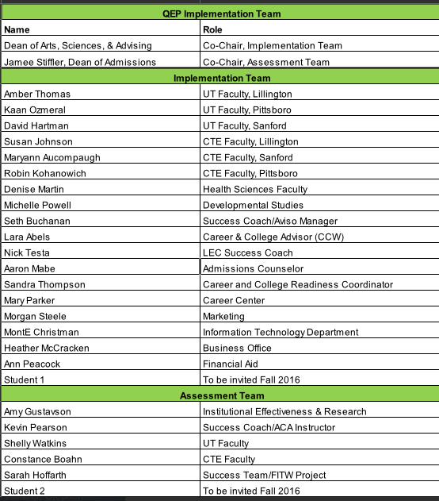
Notes:
Sarah Hoffarth – Please read everyone’s name and let them wave.

Slide 17
MAP: My Academic Pathway!
Notes:
Sarah Hoffarth
Again, our QEP for the next ten years is MAP: My Academic Pathway. On behalf of the QEP Implementation Team, we look forward to implementing this QEP!

